Slide 1
안드로이드 실무 기말 평가
1901055 정시철

Slide 2
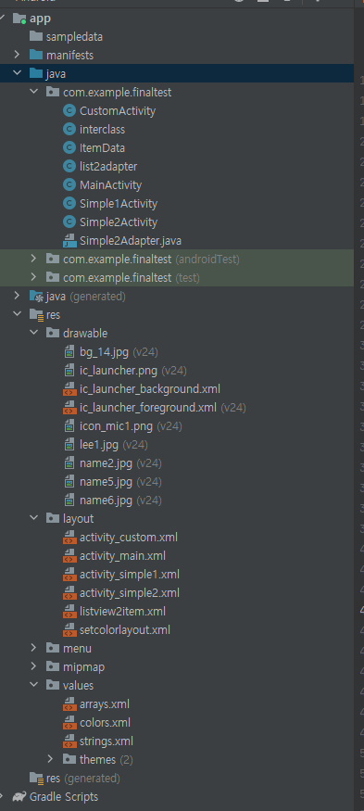
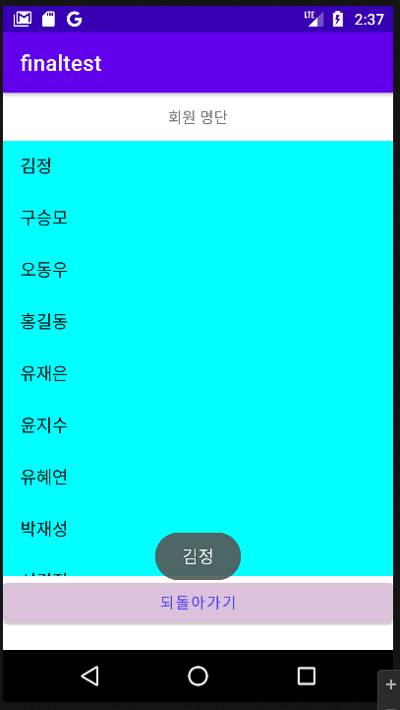
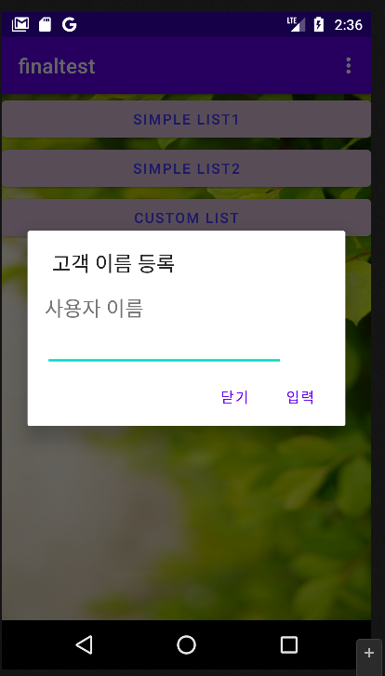
Report 1
public class MainActivity extends AppCompatActivity { SeekBar sb1, sb2, sb3; TextView ct1, ct2, ct3; Button buttoncolor,button1,button2,button3; int red=0,blue=0,green=0; int red2=0,blue2=0,green2=0; LinearLayout mainbg;ListView list;ArrayList<String> list1; @Override public boolean onCreateOptionsMenu(Menu menu) { MenuInflater inflater = getMenuInflater(); inflater.inflate(R.menu.menu,menu); return true; } @Override public boolean onOptionsItemSelected(MenuItem item) { LinearLayout itemlay = new LinearLayout(MainActivity.this); LayoutInflater inflater = (LayoutInflater) getSystemService(Context.LAYOUT_INFLATER_SERVICE); View view = inflater.inflate(R.layout.setcolorlayout, itemlay, false); sb1 = view.findViewById(R.id.sb1); sb2 = view.findViewById(R.id.sb2); sb3 = view.findViewById(R.id.sb3); ct1 = view.findViewById(R.id.ct1); ct2 = view.findViewById(R.id.ct2); ct3 = view.findViewById(R.id.ct3); buttoncolor = view.findViewById(R.id.buttoncolor); switch(item.getItemId()){ case R.id.item1: AlertDialog.Builder builder1 = new AlertDialog.Builder(MainActivity.this); EditText myname = new EditText(MainActivity.this); TextView myn = new TextView(MainActivity.this); builder1.setTitle("고객 이름 등록"); myn.setText("사용자 이름"); myn.setTextSize(20); myname.setWidth(700); LinearLayout i1lay = new LinearLayout(MainActivity.this); i1lay.addView(myn); i1lay.addView(myname); i1lay.setPadding(50, 50, 0, 0); i1lay.setOrientation(LinearLayout.VERTICAL); builder1.setView(i1lay); builder1.setPositiveButton("입력", new DialogInterface.OnClickListener() { @Override public void onClick(DialogInterface dialogInterface, int i) { }}); builder1.setNegativeButton("닫기",null); builder1.show(); break; case R.id.item2: AlertDialog.Builder builder2 = new AlertDialog.Builder(MainActivity.this); builder2.setView(view); builder2.setTitle("버튼 배경색을 선택해주세요."); builder2.setIcon(R.drawable.icon_mic1); sb1.setOnSeekBarChangeListener(new SeekBar.OnSeekBarChangeListener() { @Override public void onProgressChanged(SeekBar seekBar, int i, boolean b) { ct1.setText(String.format("RED : %d (%X)",i,i));red = i; buttoncolor.setBackgroundColor(Color.rgb(red,green,blue)); } @Override public void onStartTrackingTouch(SeekBar seekBar) { } @Override public void onStopTrackingTouch(SeekBar seekBar) { }}); sb2.setOnSeekBarChangeListener(new SeekBar.OnSeekBarChangeListener() { @Override public void onProgressChanged(SeekBar seekBar, int i, boolean b) { ct2.setText(String.format("GREEN : %d (%X)",i,i));green = i; buttoncolor.setBackgroundColor(Color.rgb(red,green,blue)); } @Override public void onStartTrackingTouch(SeekBar seekBar) { } @Override public void onStopTrackingTouch(SeekBar seekBar) { }}); sb3.setOnSeekBarChangeListener(new SeekBar.OnSeekBarChangeListener() { @Override public void onProgressChanged(SeekBar seekBar, int i, boolean b) { ct3.setText(String.format("BLUE : %d (%X)",i,i));blue = i; buttoncolor.setBackgroundColor(Color.rgb(red,green,blue)); } @Override public void onStartTrackingTouch(SeekBar seekBar) { } @Override public void onStopTrackingTouch(SeekBar seekBar) { }}); builder2.setPositiveButton("확인", new DialogInterface.OnClickListener() { @Override public void onClick(DialogInterface dialogInterface, int i) { button1.setBackgroundColor(Color.rgb(red,green,blue)); button2.setBackgroundColor(Color.rgb(red,green,blue)); button3.setBackgroundColor(Color.rgb(red,green,blue)); }}); builder2.setNegativeButton("취소",null);builder2.show();break; case R.id.item3: AlertDialog.Builder builder3 = new AlertDialog.Builder(MainActivity.this); builder3.setView(view); builder3.setTitle("버튼 글자색을 선택해주세요."); builder3.setIcon(R.drawable.icon_mic1); sb1.setOnSeekBarChangeListener(new SeekBar.OnSeekBarChangeListener() { @Override public void onProgressChanged(SeekBar seekBar, int i, boolean b) { ct1.setText(String.format("RED : %d (%X)",i,i));red2 = i; buttoncolor.setTextColor(Color.rgb(red2,green2,blue2)); } @Override public void onStartTrackingTouch(SeekBar seekBar) { } @Override public void onStopTrackingTouch(SeekBar seekBar) { }}); sb2.setOnSeekBarChangeListener(new SeekBar.OnSeekBarChangeListener() { @Override public void onProgressChanged(SeekBar seekBar, int i, boolean b) { ct2.setText(String.format("GREEN : %d (%X)",i,i));green2 = i; buttoncolor.setTextColor(Color.rgb(red2,green2,blue2)); } @Override public void onStartTrackingTouch(SeekBar seekBar) { } @Override public void onStopTrackingTouch(SeekBar seekBar) { }}); sb3.setOnSeekBarChangeListener(new SeekBar.OnSeekBarChangeListener() { @Override public void onProgressChanged(SeekBar seekBar, int i, boolean b) { ct3.setText(String.format("BLUE : %d (%X)",i,i));blue2 = i; buttoncolor.setTextColor(Color.rgb(red2,green2,blue2)); } @Override public void onStartTrackingTouch(SeekBar seekBar) { } @Override public void onStopTrackingTouch(SeekBar seekBar) { }}); builder3.setPositiveButton("확인", new DialogInterface.OnClickListener() { @Override public void onClick(DialogInterface dialogInterface, int i) { button1.setTextColor(Color.rgb(red2,green2,blue2)); button2.setTextColor(Color.rgb(red2,green2,blue2)); button3.setTextColor(Color.rgb(red2,green2,blue2)); }}); builder3.setNegativeButton("취소",null);builder3.show();break; case R.id.item4: if (item.isChecked()){ mainbg.setBackgroundResource(0); item.setChecked(false); }else{ mainbg = findViewById(R.id.mainbg); mainbg.setBackgroundResource(R.drawable.bg_14); item.setChecked(true); } } return super.onOptionsItemSelected(item); } @Override protected void onCreate(Bundle savedInstanceState) { super.onCreate(savedInstanceState); setContentView(R.layout.activity_main); button1 = findViewById(R.id.button1); button2 = findViewById(R.id.button2); button3 = findViewById(R.id.button3); button1.setOnClickListener(new View.OnClickListener() { @Override public void onClick(View view) { Intent intent = new Intent(MainActivity.this,Simple1Activity.class); intent.putExtra("red",red); intent.putExtra("green",green); intent.putExtra("blue",blue); intent.putExtra("red2",red2); intent.putExtra("green2",green2); intent.putExtra("blue2",blue2); startActivity(intent); }}); button2.setOnClickListener(new View.OnClickListener() { @Override public void onClick(View view) { Intent intent = new Intent(MainActivity.this,Simple2Activity.class); intent.putExtra("red",red); intent.putExtra("green",green); intent.putExtra("blue",blue); intent.putExtra("red2",red2); intent.putExtra("green2",green2); intent.putExtra("blue2",blue2); startActivity(intent); }}); }}
아이템 데이터
package com.example.finaltest; public class ItemData { public String title; public String date; }
메인 엑티비티
<LinearLayout xmlns:android="http://schemas.android.com/apk/res/android" xmlns:app="http://schemas.android.com/apk/res-auto" xmlns:tools="http://schemas.android.com/tools" android:layout_width="match_parent" android:orientation="vertical" android:layout_height="match_parent" tools:context=".Simple1Activity"> <LinearLayout android:id="@+id/simple1" android:orientation="vertical" android:layout_width="match_parent" android:layout_height="200pt"> <TextView android:layout_width="match_parent" android:layout_height="20pt" android:gravity="center" android:text="회원 명단"/> <ListView android:background="#00ffff" android:id="@+id/simple1list" android:divider="#ff0000" android:layout_width="match_parent" android:layout_height="match_parent"/> </LinearLayout> <Button android:layout_width="match_parent" android:layout_height="wrap_content" android:id="@+id/returned" android:text="되돌아가기"/> </LinearLayout>
리스트1액티비티
리스트1레이아웃
public class Simple1Activity extends AppCompatActivity { ArrayAdapter adapter; @Override protected void onCreate(Bundle savedInstanceState) { super.onCreate(savedInstanceState); setContentView(R.layout.activity_simple1); int red = getIntent().getIntExtra("red",0); int blue = getIntent().getIntExtra("blue",0); int green = getIntent().getIntExtra("green",0); int red2 = getIntent().getIntExtra("red2",0); int blue2 = getIntent().getIntExtra("blue2",0); int green2 = getIntent().getIntExtra("green2",0); String[] area = getResources().getStringArray(R.array.member); adapter = new ArrayAdapter(this, android.R.layout.simple_list_item_1, area); ListView list = findViewById(R.id.simple1list); list.setAdapter(adapter); Button end = findViewById(R.id.returned); if (red!=0||blue!=0||green!=0) end.setBackgroundColor(Color.rgb(red,green,blue)); if (red2!=0||blue2!=0||green2!=0) end.setTextColor(Color.rgb(red2,green2,blue2)); list.setOnItemClickListener(new AdapterView.OnItemClickListener() { @Override public void onItemClick(AdapterView<?> parent, View view, int position, long id) { Toast.makeText(getBaseContext(), area[position], Toast.LENGTH_SHORT).show(); }}); end.setOnClickListener(new View.OnClickListener() { @Override public void onClick(View view) { finish(); }}); } }
색상 전환 레이아웃
<?xml version="1.0" encoding="utf-8"?> <LinearLayout xmlns:android="http://schemas.android.com/apk/res/android" android:layout_width="match_parent" android:orientation="vertical" android:padding="5pt" android:layout_height="match_parent" android:id="@+id/colorlay"> <TextView android:id="@+id/ct1" android:layout_width="wrap_content" android:layout_height="wrap_content" android:textColor="#ff0000" android:text="RED : "/> <SeekBar android:layout_width="match_parent" android:layout_height="wrap_content" android:id="@+id/sb1" android:max="255"/> <TextView android:id="@+id/ct2" android:layout_width="wrap_content" android:layout_height="wrap_content" android:textColor="#00ff00" android:text="GREEN : "/> <SeekBar android:layout_width="match_parent" android:layout_height="wrap_content" android:id="@+id/sb2" android:max="255"/> <TextView android:id="@+id/ct3" android:layout_width="wrap_content" android:layout_height="wrap_content" android:textColor="#0000ff" android:text="BLUE : "/> <SeekBar android:layout_width="match_parent" android:layout_height="wrap_content" android:id="@+id/sb3" android:max="255"/> <Button android:id="@+id/buttoncolor" android:layout_width="wrap_content" android:layout_height="wrap_content" android:gravity="center" android:layout_gravity="center" android:text="변경 색상"/> </LinearLayout>
메인 레이아웃
<?xml version="1.0" encoding="utf-8"?> <LinearLayout xmlns:android="http://schemas.android.com/apk/res/android" xmlns:app="http://schemas.android.com/apk/res-auto" xmlns:tools="http://schemas.android.com/tools" android:layout_width="match_parent" android:orientation="vertical" android:layout_height="match_parent" android:id="@+id/mainbg" tools:context=".MainActivity"> <Button android:layout_width="match_parent" android:layout_height="wrap_content" android:id="@+id/button1" android:text="SIMPLE LIST1"/> <Button android:layout_width="match_parent" android:layout_height="wrap_content" android:id="@+id/button2" android:text="SIMPLE LIST2"/> <Button android:layout_width="match_parent" android:layout_height="wrap_content" android:id="@+id/button3" android:text="CUSTOM LIST"/> </LinearLayout>
<?xml version="1.0" encoding="utf-8"?> <LinearLayout xmlns:android="http://schemas.android.com/apk/res/android" xmlns:app="http://schemas.android.com/apk/res-auto" xmlns:tools="http://schemas.android.com/tools" android:layout_width="match_parent" android:orientation="vertical" android:layout_height="match_parent" tools:context=".Simple2Activity"> <LinearLayout android:id="@+id/simple2" android:orientation="vertical" android:layout_width="match_parent" android:layout_height="match_parent"> <TextView android:layout_width="match_parent" android:layout_height="20pt" android:gravity="center" android:text="회원 명단"/> <ListView android:background="#00ffff" android:id="@+id/simple2list" android:divider="#ff0000" android:layout_width="match_parent" android:layout_height="200pt"/> <Button android:layout_width="match_parent" android:layout_height="wrap_content" android:id="@+id/returned" android:text="되돌아가기"/> </LinearLayout> <LinearLayout android:visibility="gone" android:orientation="vertical" android:layout_width="match_parent" android:layout_height="wrap_content" android:id="@+id/simple2inter"> <TextView android:id="@+id/interfaces" android:layout_width="wrap_content" android:layout_height="wrap_content"/> <Button android:layout_width="match_parent" android:layout_height="wrap_content" android:id="@+id/returned2" android:text="돌아가기"/> </LinearLayout> </LinearLayout>
리스트2액티비티, 어댑터
public class Simple2Activity extends AppCompatActivity { ArrayAdapter adapter; @Override protected void onCreate(Bundle savedInstanceState) { super.onCreate(savedInstanceState); setContentView(R.layout.activity_simple2); int red = getIntent().getIntExtra("red",0); int blue = getIntent().getIntExtra("blue",0); int green = getIntent().getIntExtra("green",0); int red2 = getIntent().getIntExtra("red2",0); int blue2 = getIntent().getIntExtra("blue2",0); int green2 = getIntent().getIntExtra("green2",0); String[] area = getResources().getStringArray(R.array.member); String[] area2 = getResources().getStringArray(R.array.birth); String[] area3 = getResources().getStringArray(R.array.job); ArrayList<ItemData> data = new ArrayList<>(); for (int i = 0; i<area.length; i++) { ItemData item = new ItemData(); item.title = area[i]; int a = 2022 - Integer.parseInt(area2[i]); item.date = "("+a+" 세) "+area3[i]; data.add(item); } list2adapter adapter = new list2adapter(this,data); ListView list = findViewById(R.id.simple1list); list.setAdapter(adapter); Button end = findViewById(R.id.returned); Button ret = findViewById(R.id.returned2); TextView inter = findViewById(R.id.interfaces); if (red!=0||blue!=0||green!=0) end.setBackgroundColor(Color.rgb(red,green,blue)); if (red2!=0||blue2!=0||green2!=0) end.setTextColor(Color.rgb(red2,green2,blue2)); if (red!=0||blue!=0||green!=0) ret.setBackgroundColor(Color.rgb(red,green,blue)); if (red2!=0||blue2!=0||green2!=0) ret.setTextColor(Color.rgb(red2,green2,blue2)); LinearLayout listlay = findViewById(R.id.simple2); LinearLayout listinter = findViewById(R.id.simple2inter); list.setOnItemClickListener(new AdapterView.OnItemClickListener() { @Override public void onItemClick(AdapterView<?> parent, View view, int position, long id) { listlay.setVisibility(View.GONE); listinter.setVisibility(View.VISIBLE); inter.setText(position+"번째\n"+area[position]+"\n("+ (2022- Integer.parseInt(area2[position]))+"세)\n"+area3[position]); }}); end.setOnClickListener(new View.OnClickListener() { @Override public void onClick(View view) { finish(); }}); }}
리스트2 레이아웃
public class list2adapter extends BaseAdapter { LayoutInflater inflater = null;; private Activity activity; private ArrayList<ItemData> data; private int listCnt; public list2adapter(Activity act,ArrayList<ItemData> data){ this.data = data; activity = act; inflater = (LayoutInflater) activity.getSystemService( Context.LAYOUT_INFLATER_SERVICE); listCnt = data.size(); } @Override public int getCount(){ return listCnt; } @Override public Object getItem(int position) { return null; } @Override public long getItemId(int position) { return 0; } @Override public View getView(int position, View convertView, ViewGroup parent){ if (convertView == null){ convertView = inflater.inflate(R.layout.listview2item, parent, false); } TextView tt = convertView.findViewById(R.id.str1); TextView td = convertView.findViewById(R.id.str2); tt.setText(data.get(position).title); td.setText(data.get(position).date); convertView.setTag(""+position); return convertView; }}
리스트2 칸별
<?xml version="1.0" encoding="utf-8"?> <LinearLayout xmlns:android="http://schemas.android.com/apk/res/android" android:layout_width="match_parent" android:layout_height="80dp"> <LinearLayout android:layout_width="0dp" android:layout_height="match_parent" android:layout_weight="75" android:orientation="vertical"> <TextView android:id="@+id/str1" android:layout_width="match_parent" android:layout_height="0dp" android:layout_weight="60" android:gravity="center_vertical" android:paddingLeft="10dp" android:text="이름" android:textColor="#33aabb" android:textStyle="bold" /> <TextView android:id="@+id/str2" android:layout_width="match_parent" android:layout_height="0dp" android:layout_weight="40" android:gravity="center_vertical" android:paddingLeft="10dp" android:text="나이" /> </LinearLayout> <View android:layout_width="0dp" android:layout_height="match_parent" android:layout_weight="5" /> </LinearLayout>

Slide 3
시간이 부족해서 버튼3 커스텀 레이아웃까지는 미처 하지 못했습니다. 다음 학기 땐 좀 더 노력해보겠습니다.
13주차 과제 좀 올려주세요.. 모르는 거 찾아보고 싶은데 인터넷에선 좀처럼 찾기가 힘드네요.

